Slide 1



Slide 2

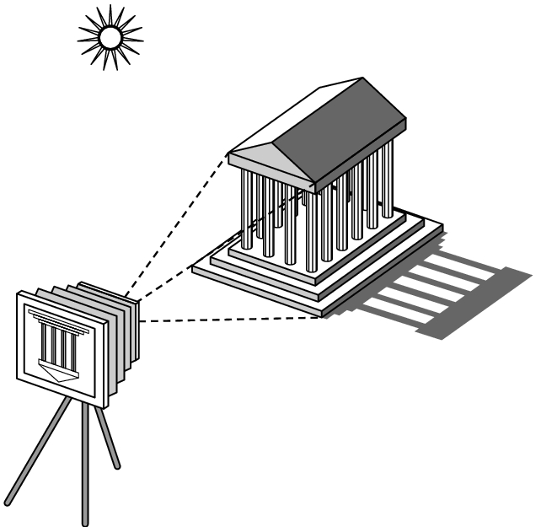
Objects
Viewer
Light sources
Attributes that govern how light interacts with the materials in the scene
Note the independence of the objects, the viewer, and the light sources

Slide 3

Light is the part of the electromagnetic spectrum that causes a reaction in our visual systems
Generally these are wavelengths in the range of about 350-750 nm (nanometers)
Long wavelengths appear as reds and short wavelengths as blues

Slide 4

Luminance Image
  Monochromatic
  Values are gray levels
  Analogous to working with black and white film or television
Color Image
  Has perceptional attributes of hue, saturation, and lightness
  Do we have to match every frequency in visible spectrum? No!

Slide 5

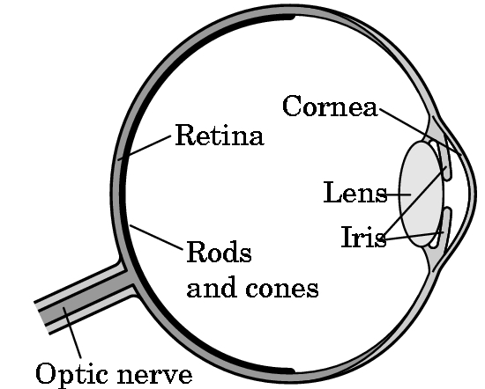
Human visual system has two types of sensors
  Rods: monochromatic, night vision
  Cones
    Color sensitive
    Three types of cones
    Only three values (the tristimulus
    values) are sent to the brain
Need only match these three values
  Need only three primary colors

Slide 6

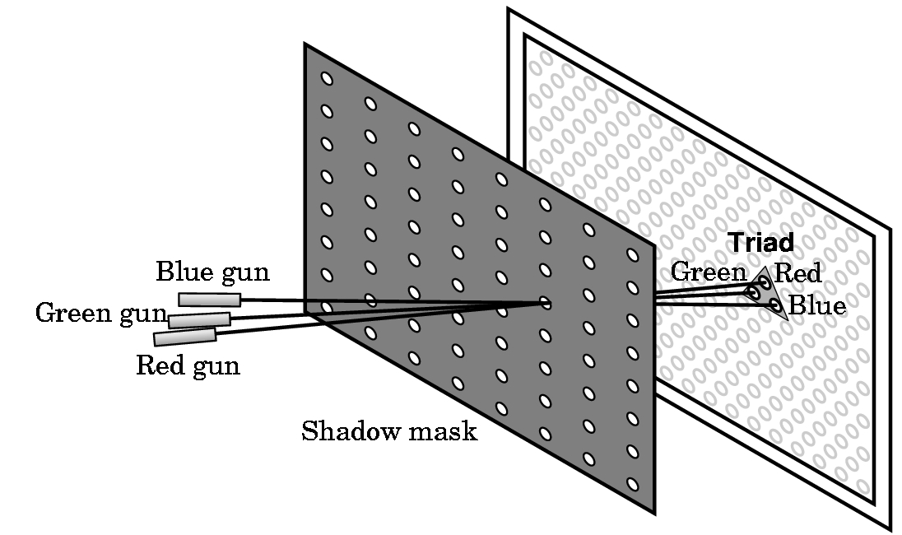

Slide 7

Additive color
  Form a color by adding amounts of three primaries
    CRTs, projection systems, positive film
  Primaries are Red (R), Green (G), Blue (B)
Subtractive color
  Form a color by filtering white light with Cyan (C), Magenta (M), and Yellow (Y) filters
    Light-material interactions
    Printing
    Negative film

Slide 8

Color and gray-scale images
  (a) R.G.B. Model:
R: Red
G: Green
B: Blue
B
Cyan
Magenta
White
Black
G
R
Yellow

Slide 9
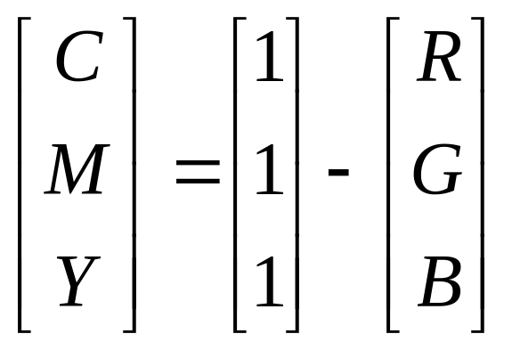
Color and gray-scale images
  (b) C.M.Y. Model:

Slide 10
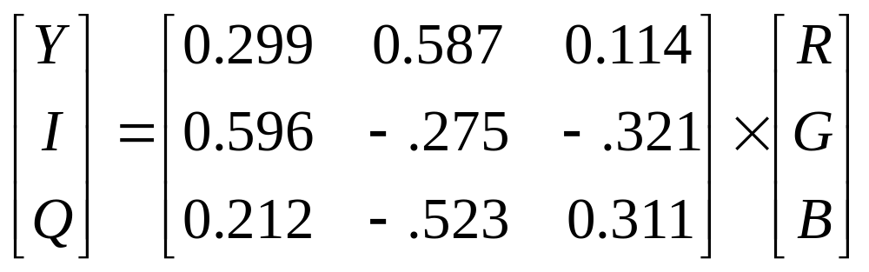
Color and gray-scale images
  (c) Y.I.Q. Model:
  Y. : Luminance information
  I. Q. : Color information

Slide 11
Color and gray-scale images
  (d) H.S.I. / H.S.V. Model:
  H. : Hue
  S. : Saturation
  I. : Intensity = (R+G+B)/3 or
  V. : max{ R, G, B}
B
G
R

Slide 12
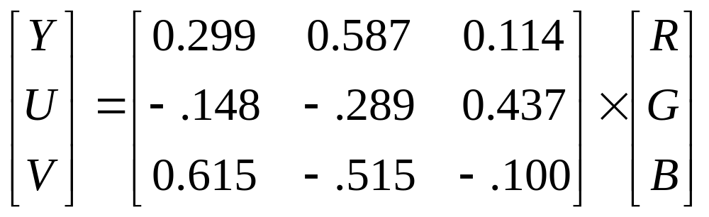
Color and gray-scale images
  (e) Y.U.V. Model:
  Y. : Luminance information
  U. V. : Color tone information

Slide 13

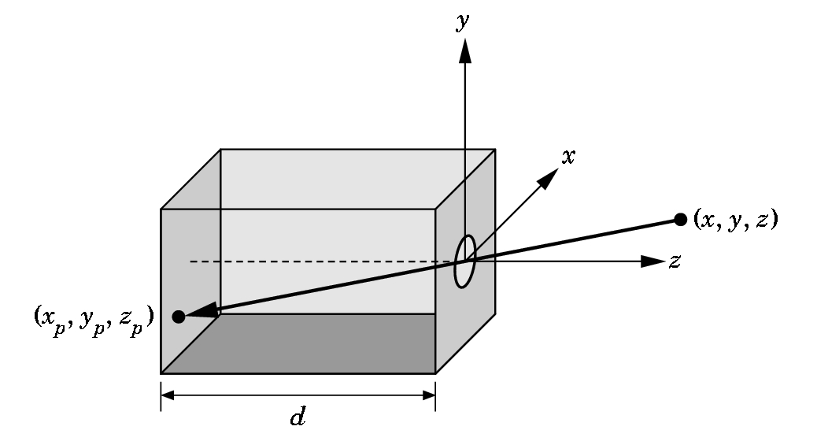
Use trigonometry to find projection of point at (x,y,z)
x_{p}= -x/z/d
y_{p}= -y/z/d
z_{p}= d
These are equations of simple perspective

Slide 14

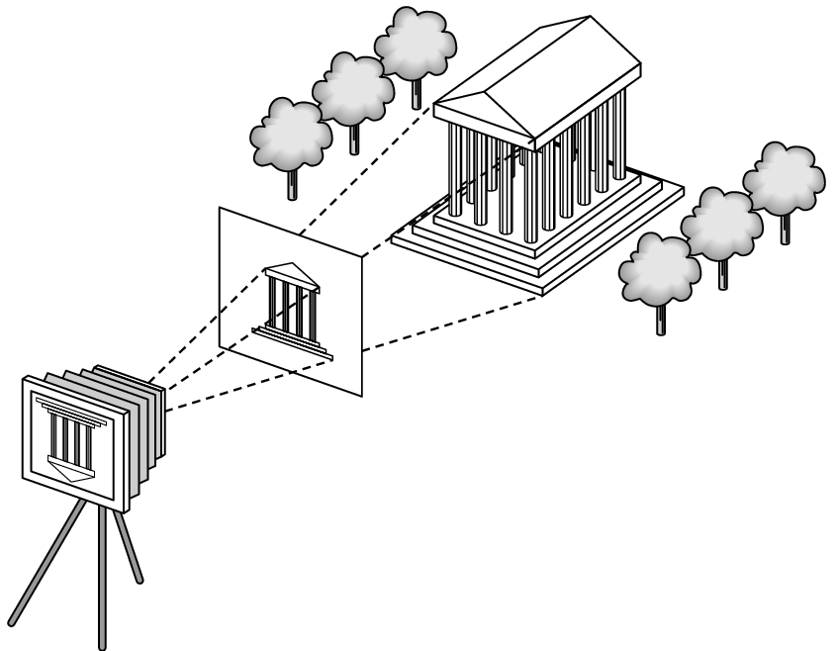
projector
p
image plane
projection of p
center of projection

Slide 15

h
Θ
d
Θ=2tan⁻¹(h/2d)

Slide 16

Separation of objects, viewer, light sources
Two-dimensional graphics is a special case of three-dimensional graphics
Leads to simple software API
  Specify objects, lights, camera, attributes
  Let implementation determine image
Leads to fast hardware implementation

Slide 17


Slide 18

Can we mimic the synthetic camera model to design graphics hardware software?
Application Programmer Interface (API)
  Need only specify
    Objects
    Materials
    Viewer
    Lights
But how is the API implemented?

Slide 19

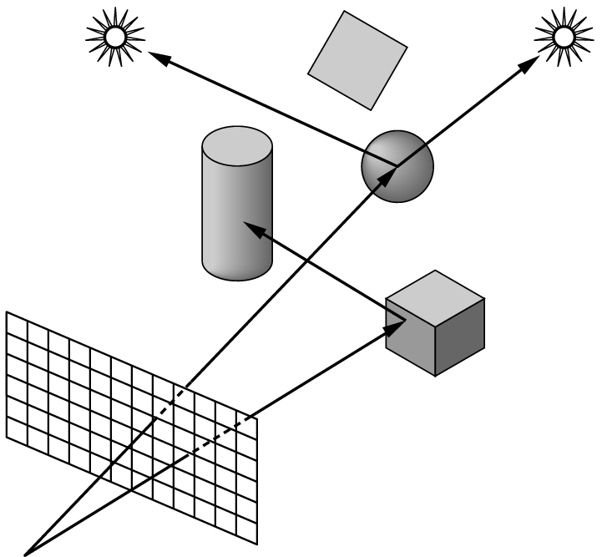
Ray tracing: follow rays of light from center of projection until they either are absorbed by objects or go off to infinity
  Can handle global effects
    Multiple reflections
    Translucent objects
  Slow
  Must have whole data base
  available at all times
Radiosity: Energy based approach
  Very slow

Slide 20

Process objects one at a time in the order they are generated by the application
  Can consider only local lighting
Pipeline architecture
All steps can be implemented in hardware on the graphics card
application
program
display

Slide 21

Much of the work in the pipeline is in converting object representations from one coordinate system to another
  Object coordinates
  Camera (eye) coordinates
  Screen coordinates
Every change of coordinates is equivalent to a matrix transformation
Vertex processor also computes vertex colors

Slide 22

Projection is the process that combines the 3D viewer with the 3D objects to produce the 2D image
  Perspective projections: all projectors meet at the center of projection
  Parallel projection: projectors are parallel, center of projection is replaced by a direction of projection

Slide 23

Vertices must be collected into geometric objects before clipping and rasterization can take place
  Line segments
  Polygons
  Curves and surfaces

Slide 24

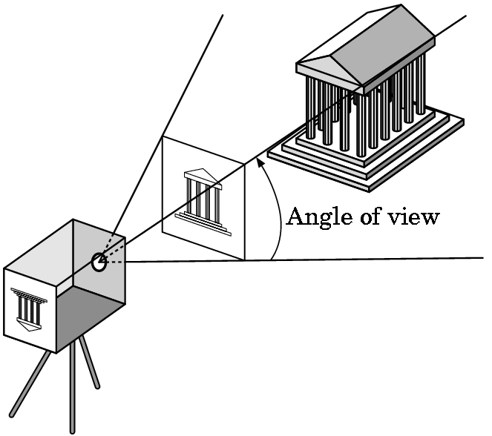
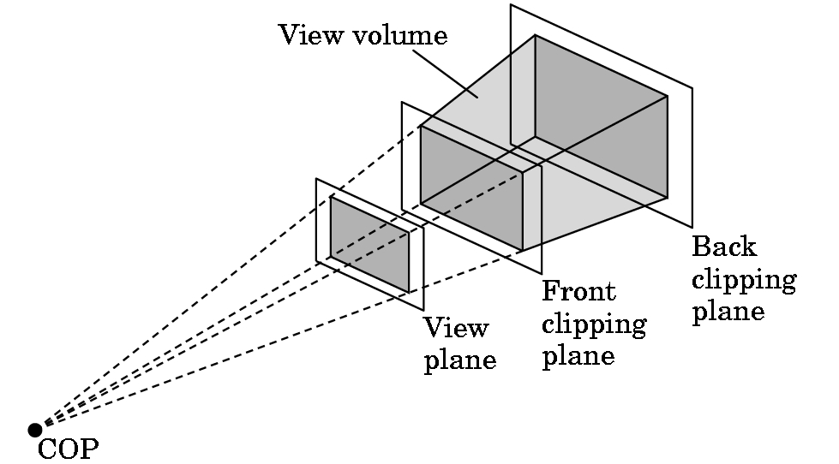
Just as a real camera cannot “see” the whole world, the virtual camera can only see part of the world or object space
  Objects that are not within this volume are said to be clipped out of the scene

Slide 25

If an object is not clipped out, the appropriate pixels in the frame buffer must be assigned colors
Rasterizer produces a set of fragments for each object
Fragments are “potential pixels”
  Have a location in frame bufffer
  Color and depth attributes
Vertex attributes are interpolated over objects by the rasterizer

Slide 26

Fragments are processed to determine the color of the corresponding pixel in the frame buffer
Colors can be determined by texture mapping or interpolation of vertex colors
Fragments may be blocked by other fragments closer to the camera
  Hidden-surface removal

Slide 27

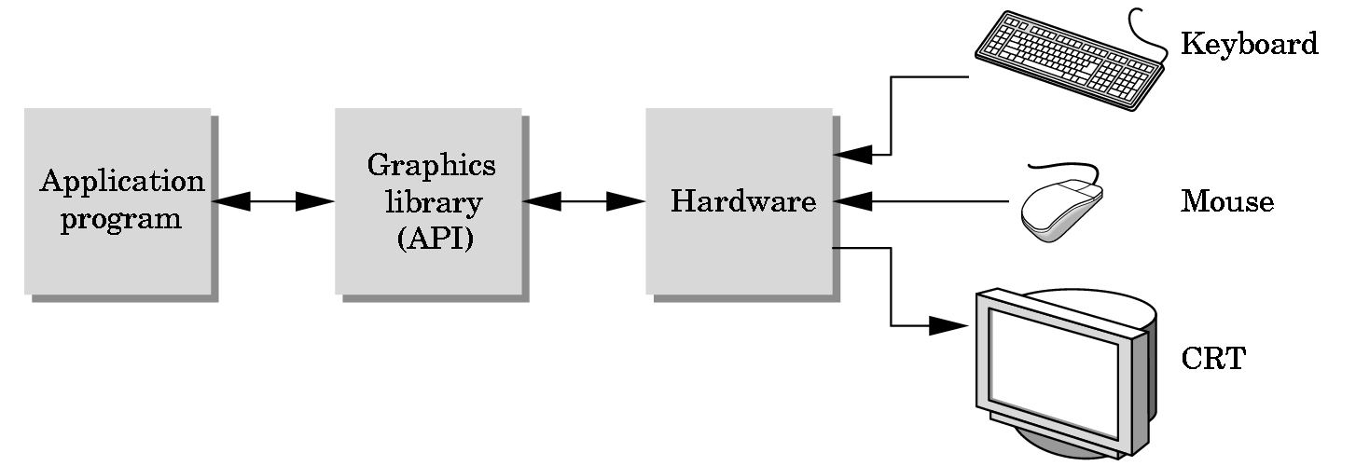
Programmer sees the graphics system through a software interface: the Application Programmer Interface (API)

Slide 28

Functions that specify what we need to form an image
  Objects
  Viewer
  Light Source(s)
  Materials
Other information
  Input from devices such as mouse and keyboard
  Capabilities of system

Slide 29

Most APIs support a limited set of primitives including
  Points (0D object)
  Line segments (1D objects)
  Polygons (2D objects)
  Some curves and surfaces
    Quadrics
    Parametric polynomials
All are defined through locations in space or vertices

Slide 30

glBegin(GL_POLYGON)
glVertex3f(0.0, 0.0, 0.0);
glVertex3f(0.0, 1.0, 0.0);
glVertex3f(0.0, 0.0, 1.0);
glEnd( );
type of object
location of vertex
end of object definition

Slide 31

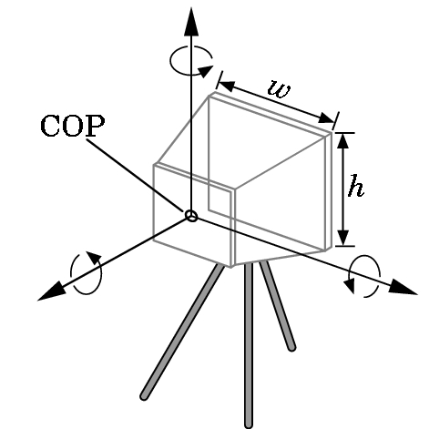
Six degrees of freedom
  Position of center of lens
  Orientation
Lens
Film size
Orientation of film plane

Slide 32

Types of lights
  Point sources vs distributed sources
  Spot lights
  Near and far sources
  Color properties
Material properties
  Absorption: color properties
  Scattering
    Diffuse
    Specular

